Slide 1



Sockets and Plugs
Extensibility without boilerplate
Stability without stagnation
Code examples available at
diffplug.com/opensource
Ned Twigg
@nedtwigg
DiffPlug
@diffplug

Slide 2
1, 1,
0, 1,
1, 2,
2 Fibonacci
1 Fibonacci again
3 Numbers
Notes:
“Congress shall make no law respecting an establishment of religion, or prohibiting the free exercise thereof; or abridging the freedom of speech, or of the press; or the right of the people peaceably to assemble, and to petition the Government for a redress of grievances”
- Easy to articulate a principle which turns out to be ambiguous.
- Lawyer technique is to say something three times:
“I promise to tell the truth, the whole truth, and nothing but the truth”
“I give, devise, and bequeath”

Slide 3


The three rules of plugin APIs
1
3
2
PLUG
SOCKET

Slide 4

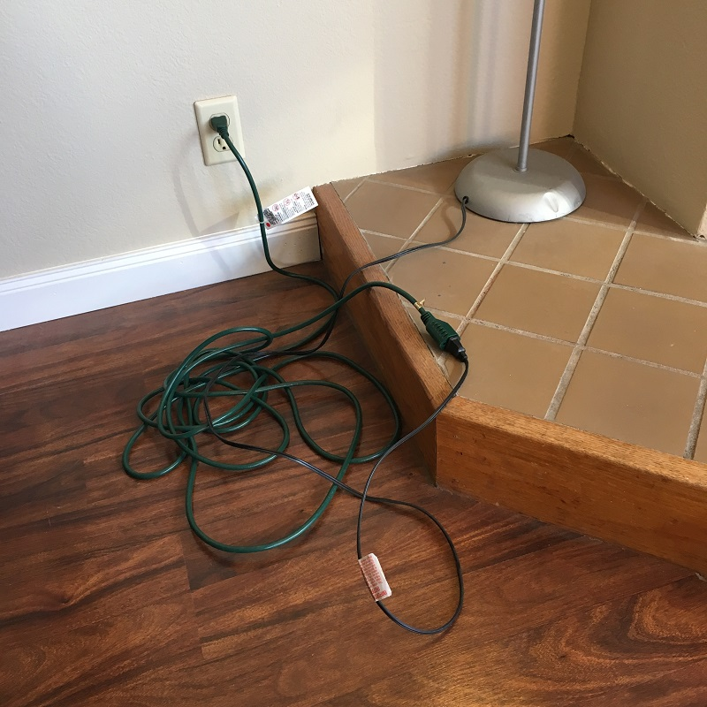
Future-proofing
Notes:
Many sockets have been written which only have one plug, with the idea that we are “future-proofing”.
YAGNI. You Aint Gonna Need It.

Slide 5
The Plan
Look at the plugin system in VSCode
Static sockets, dynamic plugs
Build a calculator in IntelliJ and Eclipse
Dynamic sockets, dynamic plugs
“Declarative” metadata
Maven vs Gradle
Propose a system with the best of all worlds
AutOSGi

Slide 6
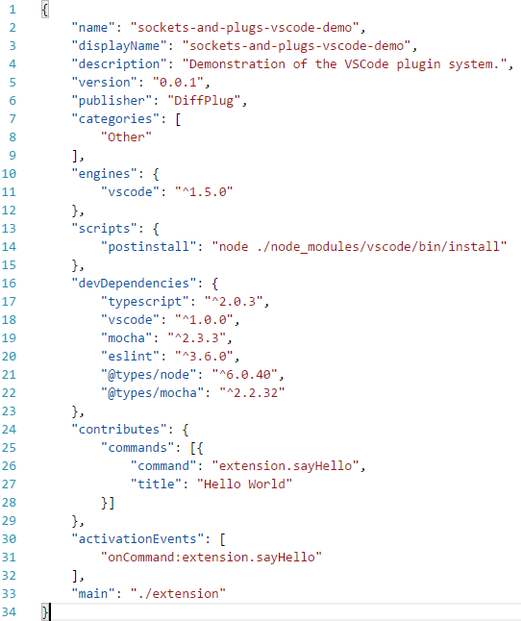
VSCode
package.json (extension manifest)
User-facing information
Similar to maven pom.xml
Dependency and build information
Plugin metadata
Notes:
VSCode -> Extension
Socket -> Contribution Point
Plug -> Contribution

Slide 7
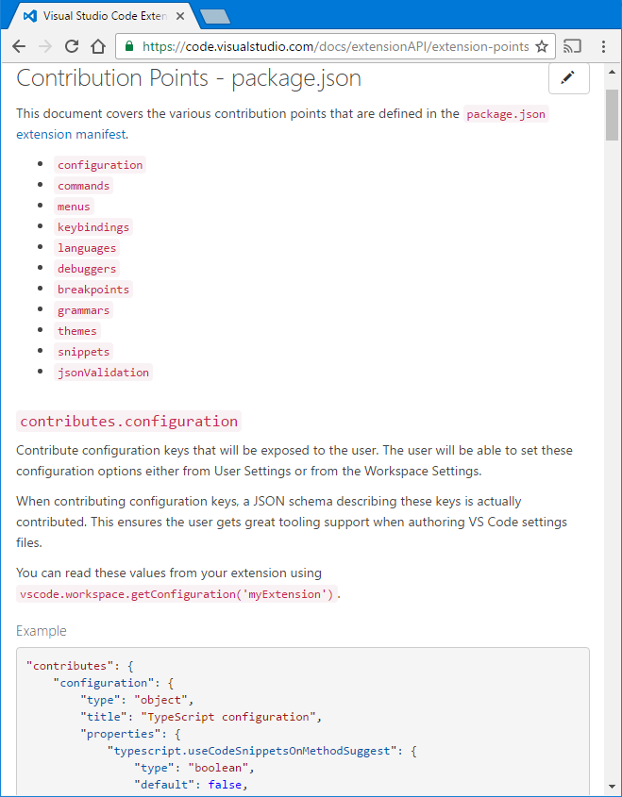
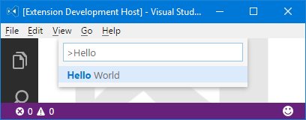
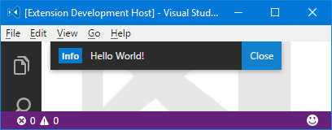
VSCode
package.json

Slide 8
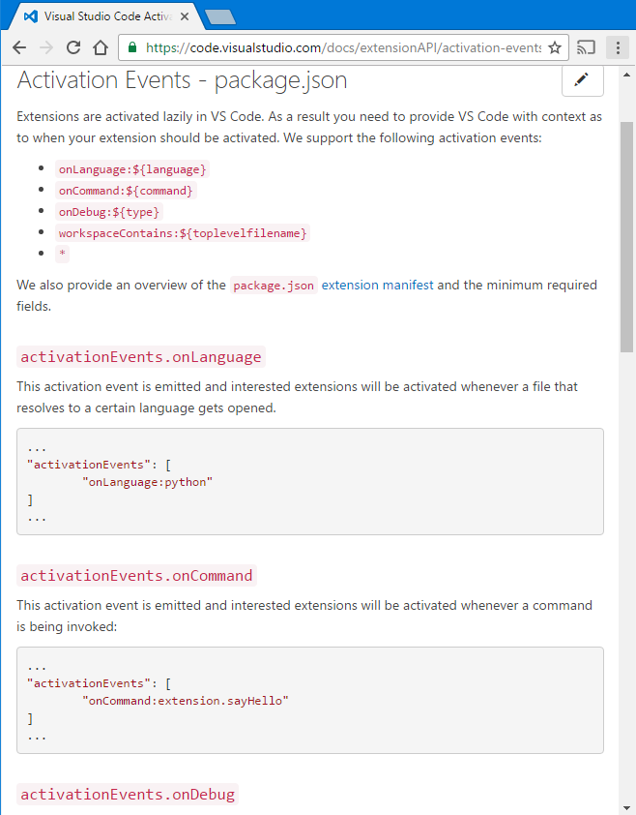
VSCode
package.json

Slide 9
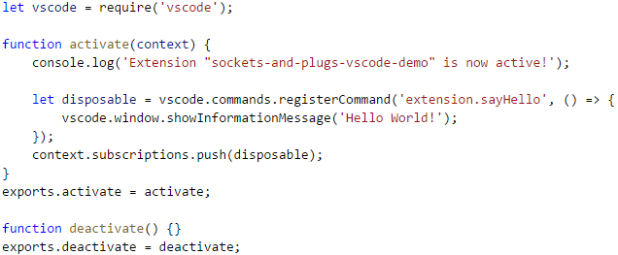
VSCode
extension.js
package.json

Slide 10
VSCode
package.json is a declarative description
What it contributes (to a fixed set of contribution points)
When to load the code (based on a fixed set of activationEvents)
Allows the code to be loaded lazily
Requires synchronizing package.json and the code

Slide 11
IntelliJ and Eclipse
Extension Point -> Socket
Extension -> Plug
public interface Operator {
double calculate(double... args);
}
public class OperatorDescriptor {
public String getName();
public Operator getInstance();
public static List<OperatorDescriptor> all();
public static OperatorDescriptor forName(String name);
}

Slide 12
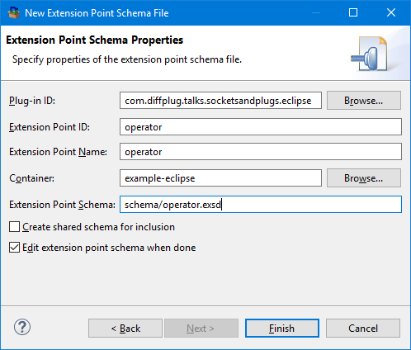
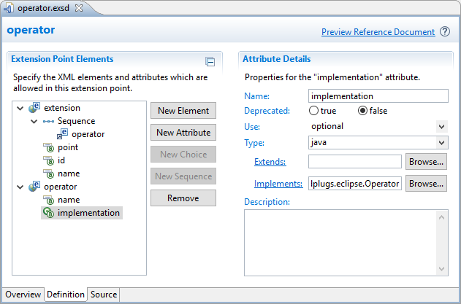
Eclipse
There are only two hard things in Computer Science: cache invalidation and naming things - Phil Karlton
SO LETS GIVE EVERYTHING
TWO NAMES!!!

Slide 13
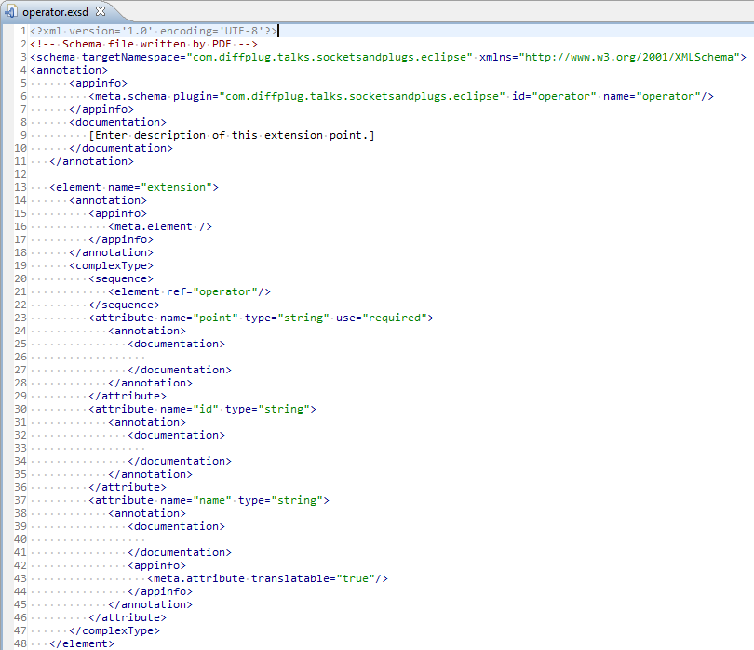
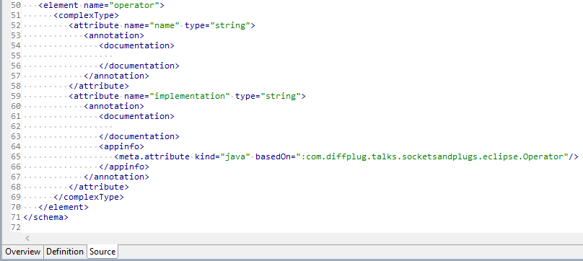
Eclipse
schema/operator.exsd

Slide 14
Eclipse
schema/operator.exsd

Slide 15
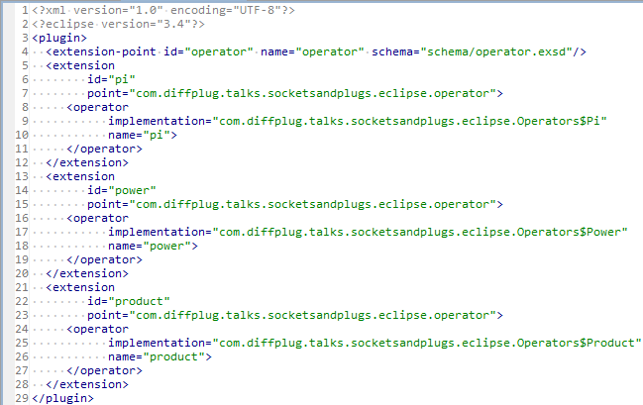
Eclipse
plugin.xml
schema/operator.exsd

Slide 16
Eclipse
plugin.xml
public class OperatorDescriptor {
public String getName();
public Operator getInstance();
public static List<OperatorDescriptor> all();
public static OperatorDescriptor forName(String name);
}

Slide 17
Eclipse
plugin.xml
public class OperatorDescriptor {
private final String name;
private final String implementation;
private OperatorDescriptor(IExtension element) {
IConfigurationElement configElement = element.getConfigurationElements()[0]
name = configElement.getAttribute("name");
implementation = configElement.getAttribute("implementation");
}
public String getName() { return name; }
private Operator instance;
public Operator instantiate() {
if (instance != null) {
return instance;
} else {
Class<?> clazz = Class.forName(implementation);
instance = (Operator) clazz.newInstance();
return instance;
}
}
…

Slide 18
Eclipse
plugin.xml
public class OperatorDescriptor {
…
/** Returns all the OperatorDescriptors in the project. */
public static List<OperatorDescriptor> all() {
IExtensionPoint point = Platform.getExtensionRegistry().getExtensionPoint(
"com.diffplug.talks.socketsandplugs.eclipse.operator");
IExtension[] extensions = point.getExtensions();
return Arrays.asList(extensions).stream()
.map(OperatorDescriptor::new)
.collect(Collectors.toList());
}
/** Returns all the OperatorDescriptors in the project. */
public static OperatorDescriptor forName(String name) {
return all().stream().filter(desc -> desc.name.equals(name)).findFirst().get();
}
}

Slide 19
Eclipse
plugin.xml
public class OperatorDescriptor {
…
/** Returns all the OperatorDescriptors in the project. */
public static List<OperatorDescriptor> all() {
IExtensionPoint point = Platform.getExtensionRegistry().getExtensionPoint(
"com.diffplug.talks.socketsandplugs.eclipse.operator");
IExtension[] extensions = point.getExtensions();
return Arrays.asList(extensions).stream()
.map(OperatorDescriptor::new)
.collect(Collectors.toList());
}
/** Returns all the OperatorDescriptors in the project. */
public static OperatorDescriptor forName(String name) {
return all().stream().filter(desc -> desc.name.equals(name)).findFirst().get();
}
}

Slide 20
Eclipse
schema/socket.exsd
Not that human-friendly XML schema
Eclipse has a nice editor for it
plugin.xml
Contains XML chunks that match the schema
SocketDescriptor.java
Parses the XML and handles the details of the chunks

Slide 21
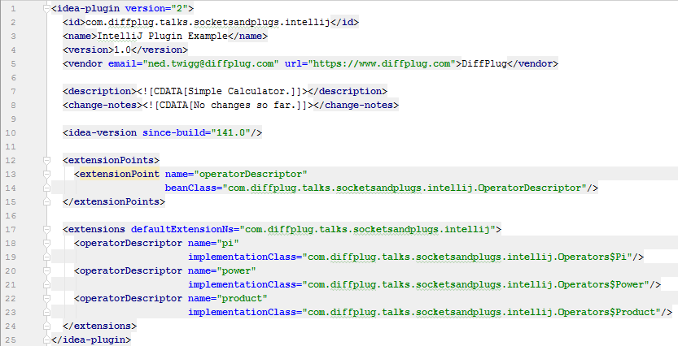
IntelliJ
plugin.xml
User-facing information
Extensions

Slide 22
IntelliJ
plugin.xml
public class OperatorDescriptor extends AbstractExtensionPointBean {
@Attribute("name")
public String name;
@Attribute("implementationClass")
public String implementation;
private Operator instance;
public Operator instantiate() {
if (instance != null) {
return instance;
} else {
Class<?> clazz = Class.forName(implementation);
instance = (Operator) clazz.newInstance();
return instance;
}
}
…

Slide 23
IntelliJ
plugin.xml
public class OperatorDescriptor extends AbstractExtensionPointBean {
…
/** Returns all the OperatorDescriptors in the project. */
public static List<OperatorDescriptor> all() {
ExtensionPointName<OperatorDescriptor> point = new ExtensionPointName<>(
"com.diffplug.talks.socketsandplugs.intellij.operatorDescriptor");
return Arrays.asList(point.getExtensions());
}
/** Returns all the OperatorDescriptors in the project. */
public static OperatorDescriptor forName(String name) {
return all().stream().filter(desc -> desc.name.equals(name)).findFirst().get();
}
}

Slide 24
IntelliJ
plugin.xml (extensionPoints)
<extensionPoint name="socketName" beanClass="SocketDescriptor"/>
SocketDescriptor.java
Extends AbstractExtensionPointBean
Marks attributes with @Attribute
plugin.xml (extensions)
<socketName attr1="value1" attr2="value2"/>

Slide 25
What do they all have in common?
Socket Interface
Contract that the Plug must satisfy
Metadata Format
Contract that the Metadata must satisfy
CONSTRAINS _
CONSTRAINS
Eclipse : schema/socket.exsd
IntelliJ: plugin.xml -> extensionPoint’s beanClass
-> AbstractExtensionPointBean -> @Attribute
VSCode : https://code.visualstudio.com/docs/
extensionAPI/extension-points
public interface Operator {
double calculate(double... args);
}
Socket Descriptor
API for declarative metadata
INSTANTIATES
PARSES
public class OperatorDescriptor {
public String getName();
public Operator getInstance();
public static List<OperatorDescriptor> all();
public static OperatorDescriptor forName(String name);
}
PARSES
Metadata
Declarative description of the plug
Plug Implementation
Implements the Socket Interface
<operator name="pi" impl="com.diffplug.Pi"/>
public class Pi implements Operator {
double calculate(double... args) {
return 3.14159;
}
}
vscode.commands.registerCommand(
'extension.sayHello', () => {
// action body
})

Slide 26
What do they all have in common?
Socket Interface
Contract that the Plug must satisfy
Socket Descriptor
API for declarative metadata about each Plug
CONSTRAINS _
CONSTRAINS
INSTANTIATES
PARSES
public interface Operator {
double calculate(double... args);
}
public class OperatorDescriptor {
public String getName();
public Operator getInstance();
public static List<OperatorDescriptor> all();
public static OperatorDescriptor forName(String name);
}
PARSES
Metadata
Declarative description of the plug
Plug Implementation
Implements the Socket Interface
<operator name="pi" impl="com.diffplug.Pi"/>
public class Pi implements Operator {
double calculate(double... args) {
return 3.14159;
}
}
vscode.commands.registerCommand(
'extension.sayHello', () => {
// action body
})

Slide 27
What is “declarative” metadata?
declare according to dictionary.com
to make known or state clearly, especially in explicit or formal terms
to manifest; reveal; show

Slide 28
Which is more declarative?
to make known or state clearly, especially in explicit or formal terms
to manifest; reveal; show
A)
B)
C)
[1, 2, 3, 4]
List<Integer> list = new ArrayList<>();
for (int i = 1; i <= 4; ++i) {
list.add(i);
}
range(1, 4)

Slide 29
Which is more declarative?
to make known or state clearly, especially in explicit or formal terms
to manifest; reveal; show
A)
B)
C)
[1, 2, 3, 4, 5, 6, 7, 8, 9, 10, 11, 12, 13, 14, 15, 16, 17, 18, 19, 20, 21, 22, 23, 24, 25, 26, 27, 28, 29, 30, 31, 32, 33, 34, 35, 36, 37, 38, 39, 40, 41, 42, 43, 44, 45, 46, 47, 48, 49, 50, 51, 52, 53, 54, 55, 56, 57, 58, 59, 60, 61, 62, 63, 69, 65, 66, 67, 68, 69, 70, 71, 72, 73, 74, 75, 76, 77, 78, 79, 80, 81, 82, 83, 84, 85, 86, 87, 88, 89, 90, 91, 92, 93, 94, 95, 96, 97, 98, 99, 100]
List<Integer> list = new ArrayList<>();
for (int i = 1; i <= 100; ++i) {
list.add(i);
}
range(1, 100)

Slide 30
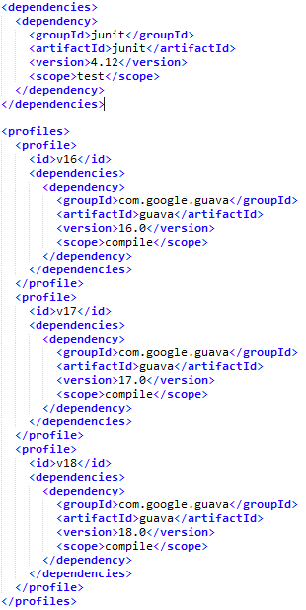
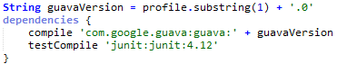
Maven vs Gradle

Slide 31
Declarative metadata
Socket Interface
Contract that the Plug must satisfy
Socket Descriptor
API for declarative metadata about each Plug
CONSTRAINS _
CONSTRAINS
INSTANTIATES
PARSES
public interface Operator {
double calculate(double... args);
}
public class OperatorDescriptor {
public String getName();
public Operator getInstance();
public static List<OperatorDescriptor> all();
public static OperatorDescriptor forName(String name);
}
GENERATES
PARSES
Implementation Detail
Mostly hidden from the developer
Metadata
Declarative description of the plug
Plug Implementation
Implements the Socket Interface
<operator name="pi" impl="com.diffplug.Pi"/>
public class Pi implements Operator {
double calculate(double... args) {
return 3.14159;
}
}

Slide 32
Declarative generated metadata - AutOSGi
Socket Interface
Contract that the Plug must satisfy
Socket Descriptor
API for declarative metadata about each Plug
CONSTRAINS _
CONSTRAINS
INSTANTIATES
PARSES
public interface Operator {
double calculate(double... args);
}
public class OperatorDescriptor {
public String getName();
public Operator getInstance();
public static List<OperatorDescriptor> all();
public static OperatorDescriptor forName(String name);
}
GENERATES
PARSES
Implementation Detail
Mostly hidden from the developer
Metadata
Declarative description of the plug
Plug Implementation
Implements the Socket Interface
<operator name="pi" impl="com.diffplug.Pi"/>
public class Pi implements Operator {
double calculate(double... args) {
return 3.14159;
}
}

Slide 33
AutOSGi
public interface Operator {
double calculate(double... args);
}
public class OperatorDescriptor {
public String getName();
public Operator getInstance();
public static List<OperatorDescriptor> all();
public static OperatorDescriptor forName(String name);
}
public class Pi implements Operator {
double calculate(double... args) {
return 3.14159;
}
}

Slide 34
AutOSGi
public interface Operator {
String name();
double calculate(double... args);
}
public class OperatorDescriptor {
public String getName();
public Operator getInstance();
public static List<OperatorDescriptor> all();
public static OperatorDescriptor forName(String name);
}
@Plug(Operator.class)
public class Pi implements Operator {
public String name() { return "pi" }
public double calculate(double... args) {
return 3.14159;
}
}
Function<Operator, Metadata>
Function<Operator, Map<String, String>>
class OperatorMetadataCreator extends
DeclarativeMetadataCreator<Operator> {
OperatorMetadataCreator() {
super(Operator.class, instance -> {
return ImmutableMap.of("name", instance.name());
});
}
}
Build steps
Find all classes annotated with @Plug(Socket.class)
Find class named SocketMetadataCreator
Instantiate the MetadataCreator and Plug
Pass the Plug to the MetadataCreator to get a Map<String, String>
Write out the metadata as an OSGi Declarative Service

Slide 35
Minor migration (1.0 -> 1.1)
public interface Operator {
String name();
double calculate(double... args);
default Range<Integer> numArgs() {
return Range.of(0, Integer.MAX_VALUE);
}
}
public class OperatorDescriptor {
public String getName();
public Operator getInstance();
public Range<Integer> getNumArgs();
public static List<OperatorDescriptor> all();
public static OperatorDescriptor forName(String name);
public static List<OperatorDescriptor> forArgs(int numArgs);
}
@Plug
public class Pi implements Operator {
public String name() { return "pi" }
public double calculate(double... args) {
return 3.14159;
}
public Range<Integer> numArgs() {
return Range.ofClosed(0, 0);
}
}
class OperatorMetadataCreator extends
DeclarativeMetadataCreator<Operator> {
OperatorMetadataCreator() {
super(Operator.class, instance -> {
return ImmutableMap.of("name", instance.name(),
"numArgs",instance.numArgs().toString());
});
}
}

Slide 36
Major migration (1.1 -> 2.0)
public interface Operator {
String name();
Future<Double> calculate(double... args);
default Range<Integer> numArgs() {
return Range.of(0, Integer.MAX_VALUE);
}
}
public class OperatorDescriptor {
public String getName();
public Operator getInstance();
public Range<Integer> getNumArgs();
public static List<OperatorDescriptor> all();
public static OperatorDescriptor forName(String name);
public static List<OperatorDescriptor> forArgs(int numArgs);
}
@Plug
public class Pi implements Operator {
public String name() { return "pi" }
public Future<Double> calculate(double... args) {
return Futures.immediate(3.14159)
}
public Range<Integer> numArgs() {
return Range.ofClosed(0, 0);
}
}
class OperatorMetadataCreator extends
DeclarativeMetadataCreator<Operator> {
OperatorMetadataCreator() {
super(Operator.class, instance -> {
return ImmutableMap.of("name", instance.name(),
"numArgs",instance.numArgs().toString());
});
}
}

Slide 37
Code examples available at
diffplug.com/opensource
Ned Twigg
@nedtwigg
DiffPlug
@diffplug

Slide 38
Stuff after this is for supporting questions

Slide 39



OSGi: Conflict diamonds
Guava

Slide 40

Boilerplate
Notes:
Image used with permission: https://www.flickr.com/mail/72157671594455393

Slide 41
IntelliJ
Components (eagerly-loaded)
Application, Project, Module
Services (lazily-loaded)
Same divisions as components, but loaded lazily
Actions
Declarative similar to VSCode’s commands
Used to be lazy-loaded, now eagerly-loaded (ref)
Extension Points and Extensions

Slide 42
Eclipse
e4
Modeled workbench
Describe application with XML
Includes declarative commands/handlers
Sits on top of OSGi
Services
Declarative services
Very powerful, very complex
Extension Points and Extensions

